Slide 1
Hyperledger Fabric
Theory and Applications of Blockchain (CS61065) - Tutorial 2

Slide 2
Hyperledger Fabric Network
Channel 1
Channel 2
Channel 3
World State
World State
World State
Ledger
Ledger
Ledger
Org_1
Org_2
Org_3
Org_4
Org_5

Slide 3
Organization
Membership Service Providers (MSP) : Identity management of members
Administrators : To manage the members (enroll, remove etc.)
Users : Typically applications connecting to the blockchain network
Peers : Hosting the chaincode and storing the ledger
Orderers (optional) : Ordering of transactions
Each organization has an ID and a network can have multiple participating organizations

Slide 4
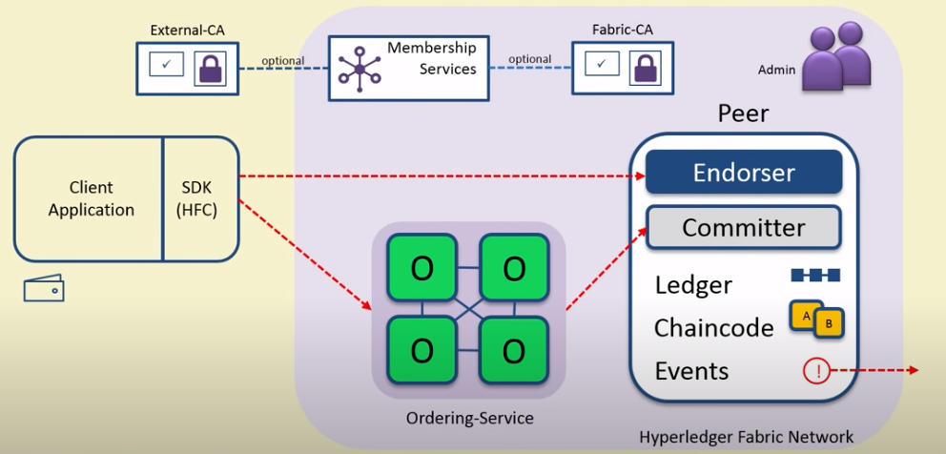
Image courtesy: NPTEL
Entities involved

Slide 5
Flow of Transactions
Endorse
Order
Validate
Client sends the transaction proposal to endorser. The endorsers return results with their signatures. The client checks if the endorsement policy is being satisfied. If yes, it sends the transaction to the orderer.
The orderer simply orders the transactions, puts them into blocks and sends it to all the peers to be validated. It does not have to look at the transactions.
The peers validate the transactions. (Check for double spending, enforcement of the endorsement policy etc.)

Slide 6
Setup prerequisites
Recommended to set up on a linux based system
Git https://git-scm.com/downloads
CURL https://curl.se/download.html
Docker Engine https://docs.docker.com/engine/install/
NodeJS (recommend to use nvm (Node Version Manager))
Docker Compose (version 1.29.2)
>> sudo groupadd docker
>> sudo usermod -aG docker $USER
To bypass using sudo every time while using docker
REQUIRED TO DO

Slide 7
Installing Hyperledger Fabric
Determine a location on your machine where you want to place the fabric-samples repository and enter that directory in a terminal window.
>> mkdir fabric
>> cd fabric
>> curl -sSL https://bit.ly/2ysbOFE | bash -s -- <fabric_version> <fabric-ca_version>
Example:
>> curl -sSL https://bit.ly/2ysbOFE | bash -s -- 2.2.4 1.5.2
(Recommended to install 2.2.4)
>> export PATH=<path to download location>/fabric-samples/bin:$PATH

Slide 8
Starting the test network with CAs
>> cd fabric-samples/test-network
>> ./network.sh up -ca
The script will start containers for each member of the test-network namely:
orderer
peer0.org1.example.com
peer0.org2.example.com
ca_org1
ca_org2
ca_orderer
cli

Slide 9
Creating a channel and deploying chaincode
>> ./network.sh createChannel -ca
Creates a channel with name "mychannel"
>> ./network.sh createChannel -c <channel name> -ca
To create a channel with a custom name

Slide 10
Deploying chain-code
>> ./network.sh -ccn <chain-code-name> –ccp <path-to-chaincode> -ccl <chaincode-language>
To deploy chaincode
Example:
>> ./network.sh -ccn basic –ccp ../asset-transfer-basic/chaincode-javascript -ccl javascript
Other optional arguments:
-ccep : To specify the endorsement policy

Slide 11
Running an application to invoke the chaincode
Example: Go to the asset-transfer-basic/application-javascript directory
The wallet directory stores the crypto material for a user issued by a CA. The CA is respawned every time we do ./network.sh up.
Before running app.js
Remove the wallet directory before running app.js.
Run >> npm install
To run the app.js file : >> node app.js

Slide 12
Other examples of interest
asset-transfer-events
While deploying the chaincode for this example set the -ccep flag to “OR(‘Org1MSP.peer’, ‘Org2MSP.peer’)”
Example on how to use event listeners

Slide 13
References
Endorsement policies — hyperledger-fabricdocs main documentation
Private data — hyperledger-fabricdocs main documentation
Private Data — hyperledger-fabricdocs main documentation - Implicit private data
Hyperledger Fabric SDK for Node.js Interface: Network - BlockEventListeners
Hyperledger Fabric SDK for Node.js Interface: Contract - ContractEventListeners
NPTEL links:
https://youtu.be/4ujj5knD3pg?si=joLsrcNJDv1l7EMk : Fabric Membership and Identity Management
https://youtu.be/xjliVltyLRk?si=IRReh8BBsUDSnWm- : Fabric Components details
https://youtu.be/nBXr7dLXAbE?si=x4vaXCHnM_nLyOGs : Fabric Transaction flow

